Slide 1
4 Component of Analysis
Exploratory Analysis (Graphs and Charts) – Already Done
Clustering to Identify Crime Hotspots - Already done
Time Series Analysis to predict number of crimes in next 12 months - Already Done
Classifying if a crime is committed by a Juvenile(based on solved crimes):
Run 4-5 models, compare performance of models, select the best one
This classification can help the police department in deciding to investigate possible juvenile subjects for unsolved crimes.
** 4th one gives us an opportunity to show case stratified sampling, neural network, decision tree, random forest, boosted tree and naïve bayers. I have executed the models, saved them and taken screenshots.
I apologize for bringing this so late, but I was experimenting the whole day to see how we can showcase our knowledge. Jump Files and PPT screenshots are uploaded in the drive.
We can discuss this in call tomorrow.

Slide 2
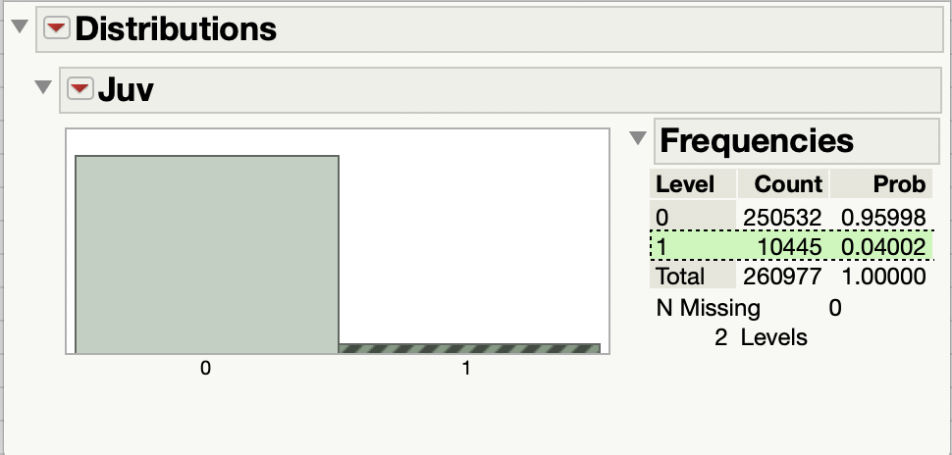
Predict if the crime if committed by a Juvenile
Pulled Data of solved cases
Created indicator column for Juvi

Slide 3
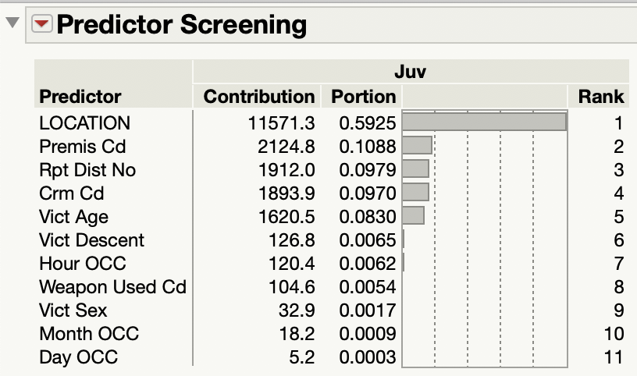
Predictor Screening –Analyzing variables (Did not work, too many values for location)
Location
Premise Code
Reporting District
Crime Code
Victim Age
Victim Desc
Victim Sex

Slide 4
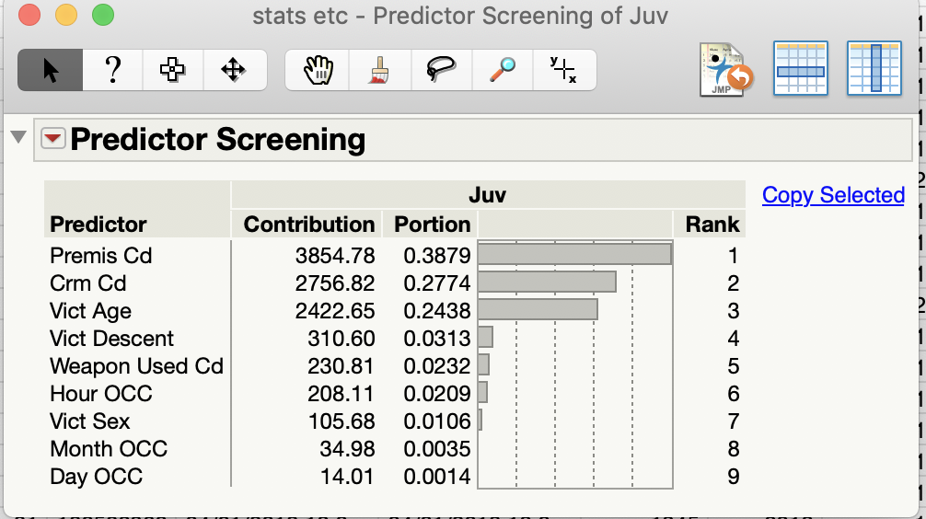
Predictor Screening –Analyzing variables
Premise Code
Crime Code
Victim Age
Victim Desc
Victim Sex
Weapon Code
Hour of OCC
We re going to exclude Month and Day from the data

Slide 5
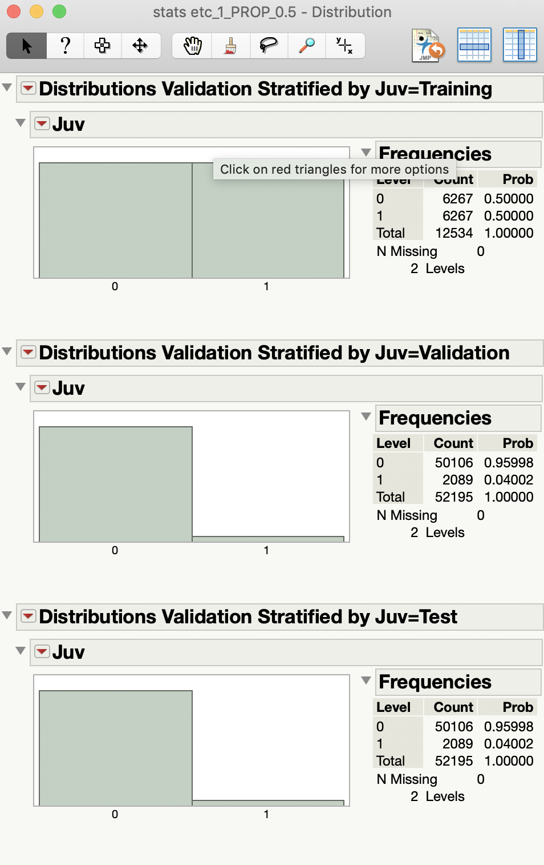
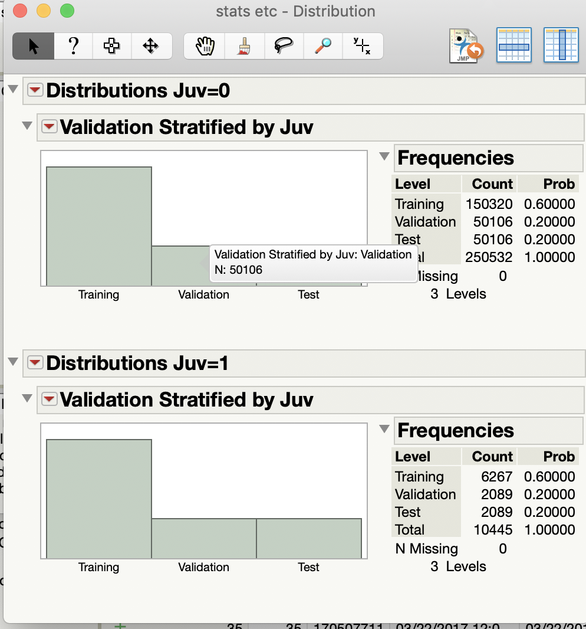
Create Training, validation and test data
Using stratified split
with 1 as Focal group as number of 1st are low.

Slide 6
Nominal Logistic – Was not able to run
Data is not linear separable. It is a linear model, so it wont work on this dataset as most of the variables are catgorical

Slide 7
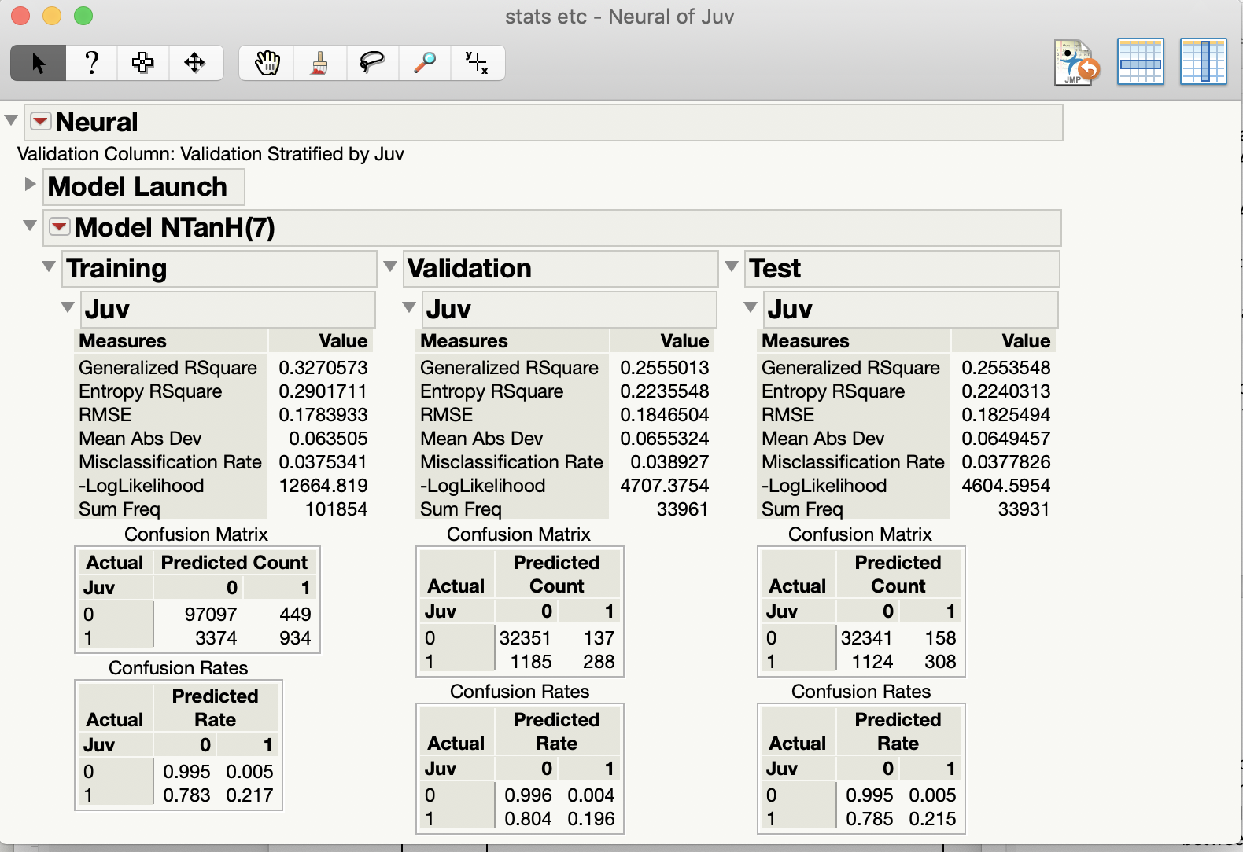
Neural Network

Slide 8
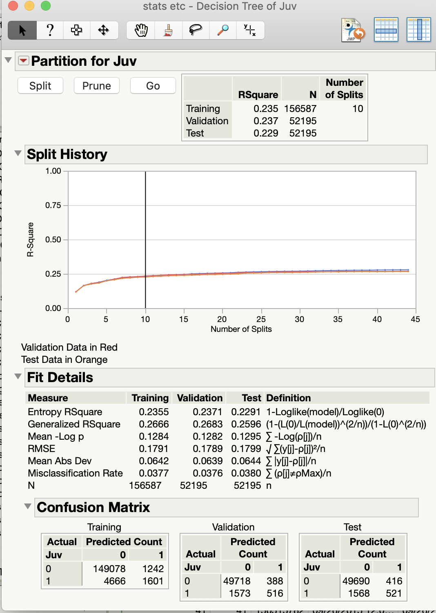
Decision Tree

Slide 9
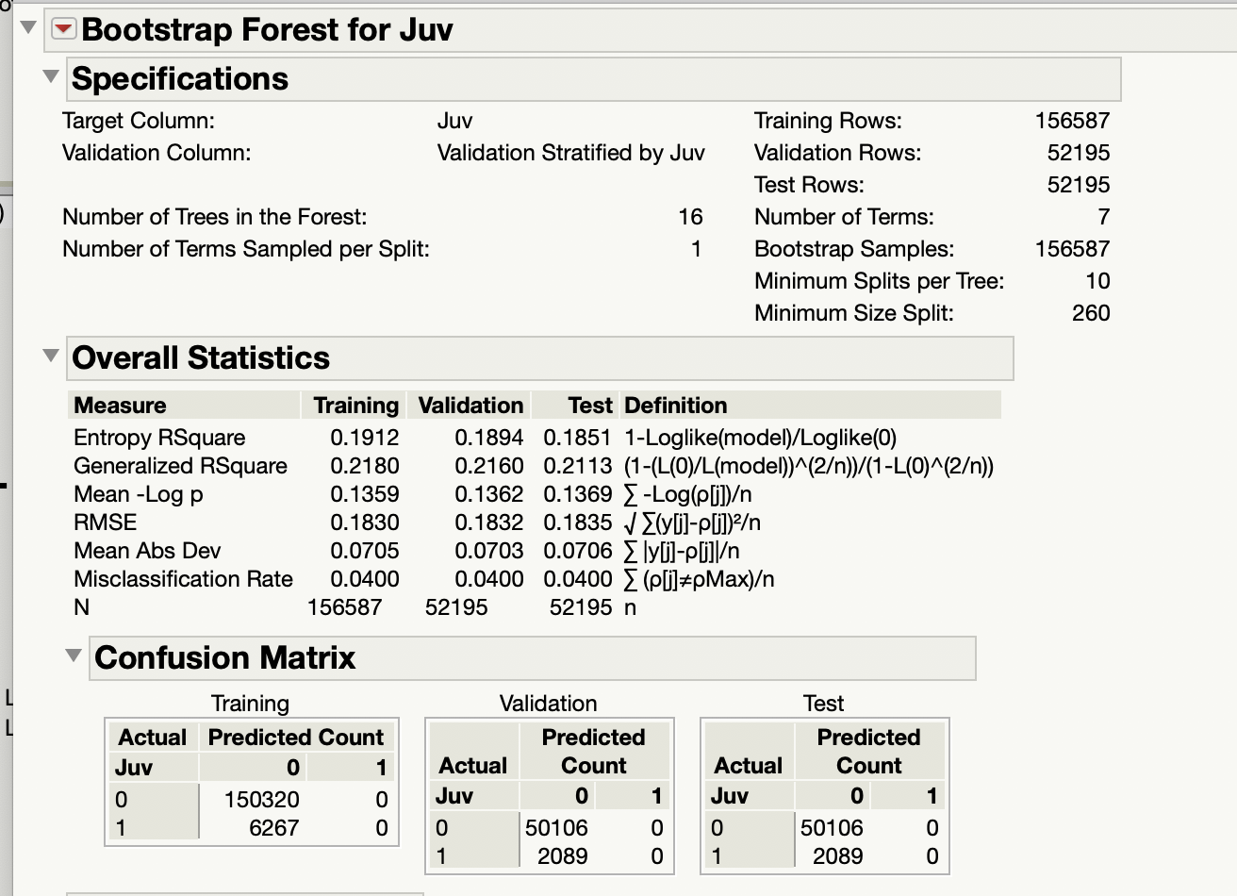
Random Forest

Slide 10
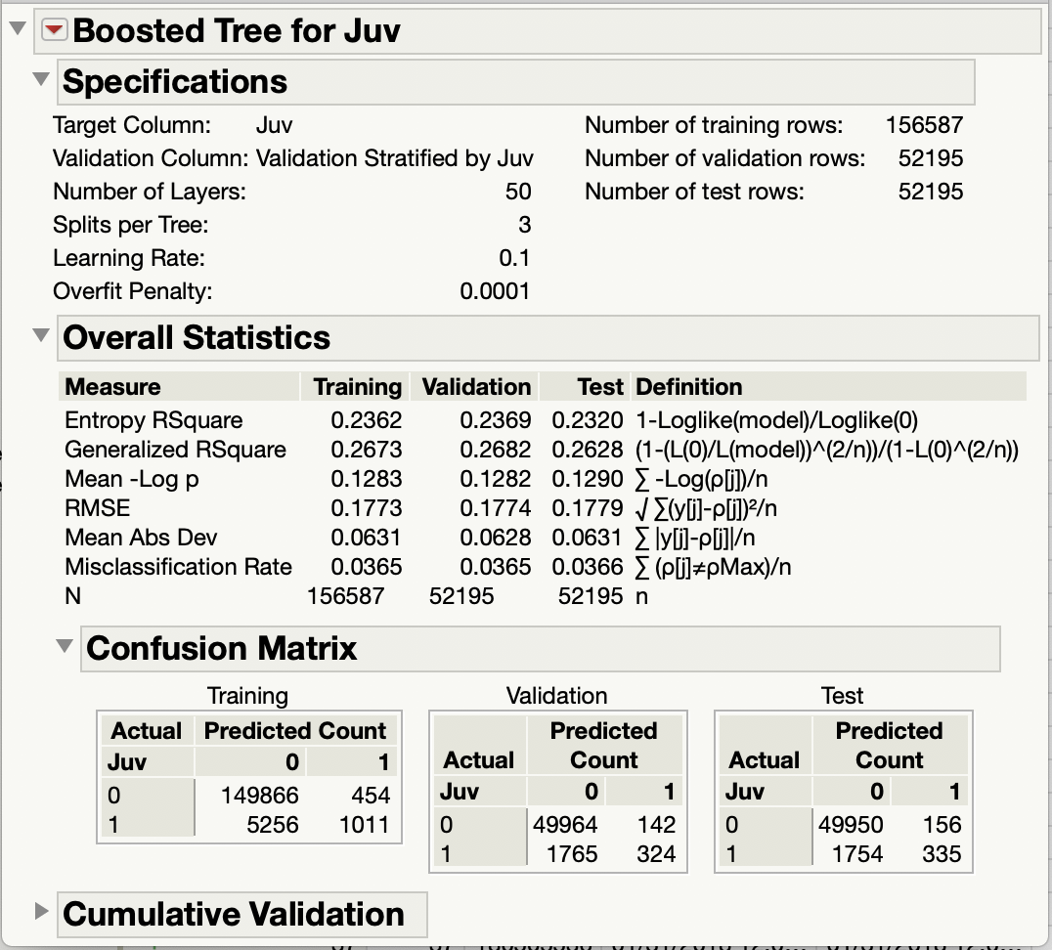
Boosted Tree

Slide 11
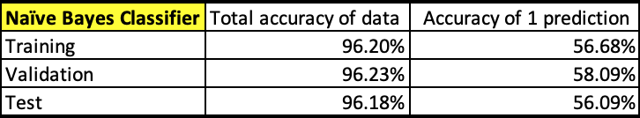
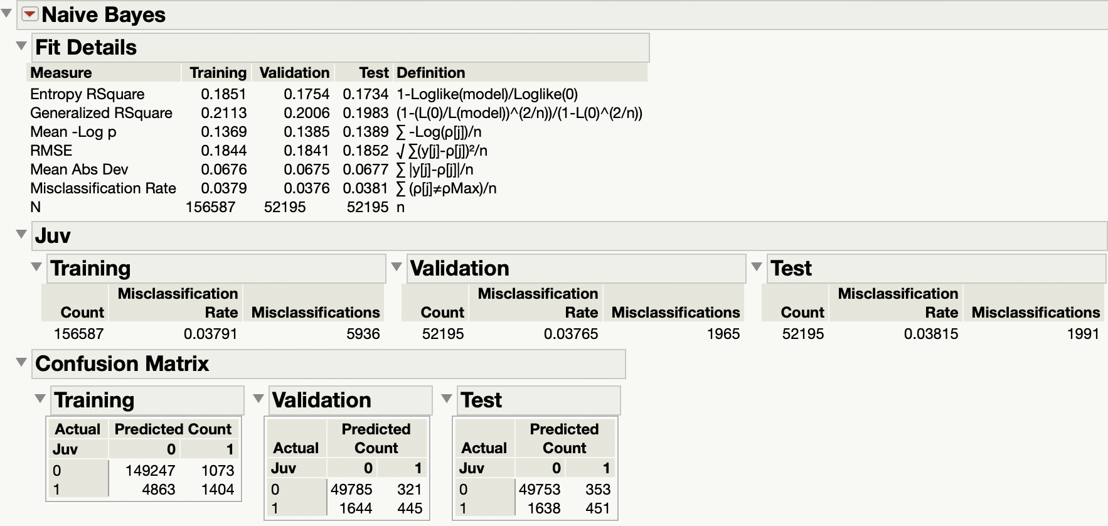
Naïve Bayes Classifier

